Slide 1

William Stallings Computer Organization and Architecture 9th Edition
Notes:
Lecture slides prepared for “Computer Organization and Architecture”, 9/e, by William Stallings, Chapter 5 “Internal Memory”.

Slide 2
Bölüm 5
Dahili Bellek
Notes:
We begin this chapter with a survey of semiconductor main memory subsystems,
including ROM, DRAM, and SRAM memories. Then we look at error control
techniques used to enhance memory reliability. Following this, we look at more
advanced DRAM architectures.

Slide 3
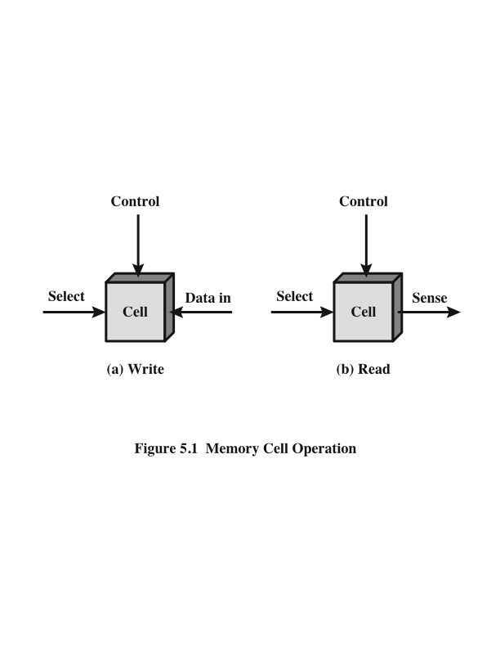
Bellek Hücresi İşlemi
Notes:
In earlier computers, the most common form of random-access storage for computer
main memory employed an array of doughnut-shaped ferromagnetic loops
referred to as cores. Hence, main memory was often referred to as core, a term that
persists to this day. The advent of, and advantages of, microelectronics has long
since vanquished the magnetic core memory. Today, the use of semiconductor chips
for main memory is almost universal. Key aspects of this technology are explored
in this section.
The basic element of a semiconductor memory is the memory cell. Although a variety
of electronic technologies are used, all semiconductor memory cells share certain
properties:
• They exhibit two stable (or semistable) states, which can be used to represent
binary 1 and 0.
• They are capable of being written into (at least once), to set the state.
• They are capable of being read to sense the state.
Figure 5.1 depicts the operation of a memory cell. Most commonly, the cell
has three functional terminals capable of carrying an electrical signal. The select
terminal, as the name suggests, selects a memory cell for a read or write operation.
The control terminal indicates read or write. For writing, the other terminal
provides an electrical signal that sets the state of the cell to 1 or 0. For reading, that
terminal is used for output of the cell’s state. The details of the internal organization,
functioning, and timing of the memory cell depend on the specific integrated
circuit technology used and are beyond the scope of this book, except for a brief
summary. For our purposes, we will take it as given that individual cells can be
selected for reading and writing operations.

Slide 4
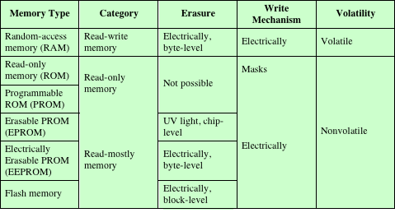
Yarı İletken Bellek Türleri
Tablo 5.1 Yarı İletken Bellek Türleri
Notes:
All of the memory types that we will explore in this chapter are random access. That is,
individual words of memory are directly accessed through wired-in addressing logic.
Table 5.1 lists the major types of semiconductor memory. The most common
is referred to as random-access memory (RAM). This is, in fact, a misuse of the
term, because all of the types listed in the table are random access. One distinguishing
characteristic of memory that is designated as RAM is that it is possible
both to read data from the memory and to write new data into the memory easily
and rapidly. Both the reading and writing are accomplished through the use of
electrical signals.
The other distinguishing characteristic of RAM is that it is volatile. A RAM
must be provided with a constant power supply. If the power is interrupted, then
the data are lost. Thus, RAM can be used only as temporary storage. The two traditional
forms of RAM used in computers are DRAM and SRAM.

Slide 5
Dinamik RAM (DRAM)
Günümüzde iki farklı RAM teknolojisi bulunmaktadır:
Dinamik RAM (DRAM)
Statik RAM (SRAM)
DRAM
Verileri kapasitörlerde yük şeklinde saklayan hücreler ile gerçeklenir
Bir kapasitörde yükün olup olmadığı ikili sayı sistemindeki 1 veya 0 ile yorumlanır
Bu tür bellekler veriyi tutabilmek için sabit elektrik akımına ihtiyaç duyarlar. Dolayısıyla RAM hücreleri elektrik sinyali gönderilerek sürekli yenilenir. Yani yüklerle yeniden yüklenmesi gerekmektedir
Dinamik terimi, sürekli olarak uygulanan güçle bile, depolanan şarjın sızıntı eğilimi anlamına gelir
Notes:
RAM technology is divided into two technologies: dynamic and
static. A dynamic RAM (DRAM) is made with cells that store data as charge on
capacitors. The presence or absence of charge in a capacitor is interpreted as a
binary 1 or 0. Because capacitors have a natural tendency to discharge, dynamic
RAMs require periodic charge refreshing to maintain data storage. The term
dynamic refers to this tendency of the stored charge to leak away, even with power
continuously applied.

Slide 6
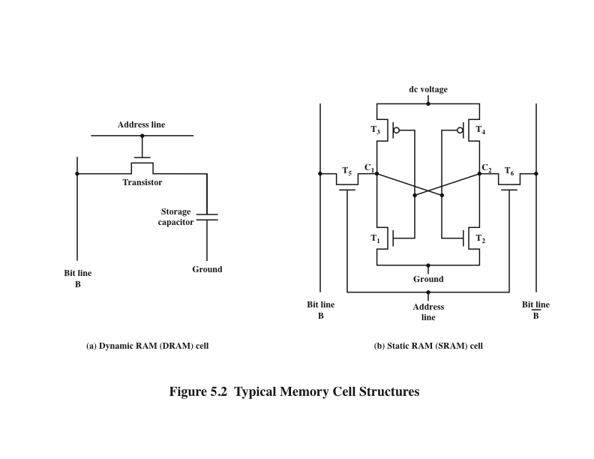
Dinamik RAM’in Yapısı
Şekil 5.2a
Tipik Bellek Hücresi Yapıları
Notes:
Figure 5.2a is a typical DRAM structure for an individual cell that stores 1 bit.
The address line is activated when the bit value from this cell is to be read or written.
The transistor acts as a switch that is closed (allowing current to flow) if a voltage is
applied to the address line and open (no current flows) if no voltage is present on
the address line.
For the write operation, a voltage signal is applied to the bit line; a high voltage
represents 1, and a low voltage represents 0. A signal is then applied to the
address line, allowing a charge to be transferred to the capacitor.
For the read operation, when the address line is selected, the transistor turns
on and the charge stored on the capacitor is fed out onto a bit line and to a sense
amplifier. The sense amplifier compares the capacitor voltage to a reference value
and determines if the cell contains a logic 1 or a logic 0. The readout from the cell
discharges the capacitor, which must be restored to complete the operation.
Although the DRAM cell is used to store a single bit (0 or 1), it is essentially
an analog device. The capacitor can store any charge value within a range; a threshold
value determines whether the charge is interpreted as 1 or 0.

Slide 7
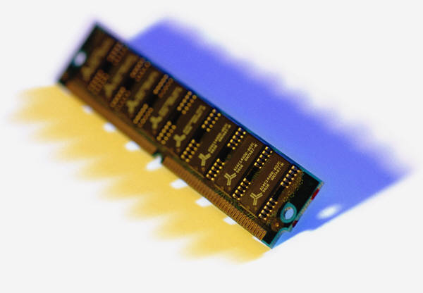
Statik RAM (SRAM)
İşlemcide kullanılan aynı mantık elemanlarını kullanan dijital aygıt
İkili değerler, geleneksel flip-flop mantık kapısı konfigürasyonları kullanılarak saklanır
Enerji sağlandığı sürece verilerini tutar
Notes:
In contrast, a static RAM (SRAM) is a digital device that uses the
same logic elements used in the processor. In a SRAM, binary values are stored
using traditional flip-flop logic-gate configurations (see Chapter 11 for a description
of flip-flops). A static RAM will hold its data as long as power is supplied to it.

Slide 8
Statik RAM’in Yapısı
Şekil 5.2b
Tipik Bellek Hücresi Yapıları
Notes:
Figure 5.2b is a typical SRAM structure for an individual cell. Four transistors
(T₁, T₂, T₃, T₄) are cross connected in an arrangement that produces a stable logic
state. In logic state 1, point C₁ is high and point C₂ is low; in this state, T₁ and T₄ are off
and T₂ and T₃ are on. In logic state 0, point C₁ is low and point C₂ is high; in this state,
T₁ and T₄ are on and T₂ and T₃ are off. Both states are stable as long as the direct
current (dc) voltage is applied. Unlike the DRAM, no refresh is needed to retain data.
As in the DRAM, the SRAM address line is used to open or close a switch.
The address line controls two transistors (T₅ and T₆). When a signal is applied to
this line, the two transistors are switched on, allowing a read or write operation. For
a write operation, the desired bit value is applied to line B, while its complement
is applied to line B. This forces the four transistors (T₁, T₂, T₃, T₄) into the proper
state. For a read operation, the bit value is read from line B.

Slide 9
SRAM ve DRAM Karşılaştırması
SRAM
Her ikisi de geçici
Bit değerlerini korumak için güç belleğe sürekli olarak verilmelidir
Dinamik hücre
Yapımı daha kolay, daha küçük
Daha yoğun (daha küçük hücreler = Birim alan başına daha fazla hücre)
Daha ucuz
Yenileme devre sistemini desteklemesi gerekir
Büyük bellek gereksinimini tercih eder
Ana bellek için kullanılır
Statik
Daha hızlı
Önbellek için kullanılır (on chip ve off chip’in her ikisi için)
DRAM
Notes:
Both static and dynamic RAMs are volatile; that is,
power must be continuously supplied to the memory to preserve the bit values.
A dynamic memory cell is simpler and smaller than a static memory cell. Thus, a
DRAM is more dense (smaller cells = more cells per unit area) and less expensive
than a corresponding SRAM. On the other hand, a DRAM requires the supporting
refresh circuitry. For larger memories, the fixed cost of the refresh circuitry is more
than compensated for by the smaller variable cost of DRAM cells. Thus, DRAMs
tend to be favored for large memory requirements. A final point is that SRAMs are
somewhat faster than DRAMs. Because of these relative characteristics, SRAM is
used for cache memory (both on and off chip), and DRAM is used for main memory.

Slide 10
Sadece Okunabilir Bellek (Read Only Memory-ROM)
Değiştirilemeyen veya ekleneme yapılamayan kalıcı bir veri modeli içerir
Bellekteki bit değerlerini korumak için güç kaynağı gerekmez
Veri veya program sürekli olarak ana bellekte bulunur ve hiçbir zaman bir ikincil depolama cihazından yüklenmesi gerekmez
Veri aslında üretim sürecinin bir parçası olarak yongadadır:
Bunun dezavantajları:
Hataya yer yok, eğer bir bit yanlışsa bütün ROM yığınları atılmalıdır
Veri ekleme adımı nispeten büyük bir sabit maliyet içerir
Notes:
As the name suggests, a read-only memory (ROM) contains a permanent pattern
of data that cannot be changed. A ROM is nonvolatile; that is, no power source is
required to maintain the bit values in memory. While it is possible to read a ROM,
it is not possible to write new data into it. An important application of ROMs is
microprogramming, discussed in Part Four. Other potential applications include
• Library subroutines for frequently wanted functions
• System programs
• Function tables
For a modest-sized requirement, the advantage of ROM is that the data or program
is permanently in main memory and need never be loaded from a secondary storage
device.
A ROM is created like any other integrated circuit chip, with the data actually
wired into the chip as part of the fabrication process. This presents two problems:
• The data insertion step includes a relatively large fixed cost, whether one or
thousands of copies of a particular ROM are fabricated.
• There is no room for error. If one bit is wrong, the whole batch of ROMs must
be thrown out.

Slide 11
Programlanabilir ROM (PROM)
Daha ucuz alternatif
Değişken değildir ve sadece bir kere yazılabilir
Yazma işlemi elektriksel olarak gerçekleştirilir ve tedarikçi veya müşteri tarafından orijinal çip imalatından sonraki bir zamanda gerçekleştirilebilir
Yazım işlemi için özel ekipman gereklidir
Esneklik ve kolaylık sağlar
Yüksek hacimli üretim çalışmaları için cazip
Notes:
When only a small number of ROMs with a particular memory content is
needed, a less expensive alternative is the programmable ROM (PROM). Like the
ROM, the PROM is nonvolatile and may be written into only once. For the PROM,
the writing process is performed electrically and may be performed by a supplier
or customer at a time later than the original chip fabrication. Special equipment is
required for the writing or “programming” process. PROMs provide flexibility and
convenience. The ROM remains attractive for high-volume production runs.

Slide 12
Read-Mostly Bellek
EPROM
Silinip Programlanabilir Salt Okunur Bellek
(Erasable programmable read-only memory)
Silme işlemi tekrar tekrar yapılabilir
PROM'dan daha pahalıdır, ancak birden fazla güncelleme kabiliyeti avantajına sahiptir
EEPROM
Elektriksel Olarak Silinip Programlanabilir Salt Okunur Bellek
(Electrically erasable programmable read-only memory)
Önceki içerikleri silmeksizin herhangi bir zamanda yazılabilir
Geçici olmamanın avantajını, güncellenebilir esneklik ile birleştirir.
EPROM’dan daha pahalıdır
Flash Bellek
Hem maliyet hem de işlevsellik açısından EPROM ve EEPROM arasındadır
Elektriksel silme teknolojisi kullanır, bayt düzeyi silme sağlamaz
Mikroçip, hafıza hücrelerinin bir bölümünün tek bir işlemle silinmesi için düzenlenmiştir ya da “flash”
Notes:
Another variation on read-only memory is the read-mostly memory, which is
useful for applications in which read operations are far more frequent than write
operations but for which nonvolatile storage is required. There are three common
forms of read-mostly memory: EPROM, EEPROM, and flash memory.
The optically erasable programmable read-only memory (EPROM) is read
and written electrically, as with PROM. However, before a write operation, all the
storage cells must be erased to the same initial state by exposure of the packaged
chip to ultraviolet radiation. Erasure is performed by shining an intense ultraviolet
light through a window that is designed into the memory chip. This erasure process
can be performed repeatedly; each erasure can take as much as 20 minutes to
perform. Thus, the EPROM can be altered multiple times and, like the ROM and
PROM, holds its data virtually indefinitely. For comparable amounts of storage, the
EPROM is more expensive than PROM, but it has the advantage of the multiple
update capability.
A more attractive form of read-mostly memory is electrically erasable programmable
read-only memory (EEPROM). This is a read-mostly memory that can
be written into at any time without erasing prior contents; only the byte or bytes
addressed are updated. The write operation takes considerably longer than the read
operation, on the order of several hundred microseconds per byte. The EEPROM
combines the advantage of non-volatility with the flexibility of being updatable in
place, using ordinary bus control, address, and data lines. EEPROM is more expensive
than EPROM and also is less dense, supporting fewer bits per chip.
Another form of semiconductor memory is flash memory (so named because
of the speed with which it can be reprogrammed). First introduced in the mid-1980s,
flash memory is intermediate between EPROM and EEPROM in both cost and
functionality. Like EEPROM, flash memory uses an electrical erasing technology.
An entire flash memory can be erased in one or a few seconds, which is much faster
than EPROM. In addition, it is possible to erase just blocks of memory rather than
an entire chip. Flash memory gets its name because the microchip is organized so
that a section of memory cells are erased in a single action or “flash.” However,
flash memory does not provide byte-level erasure. Like EPROM, flash memory
uses only one transistor per bit, and so achieves the high density (compared with
EEPROM) of EPROM.

Slide 13
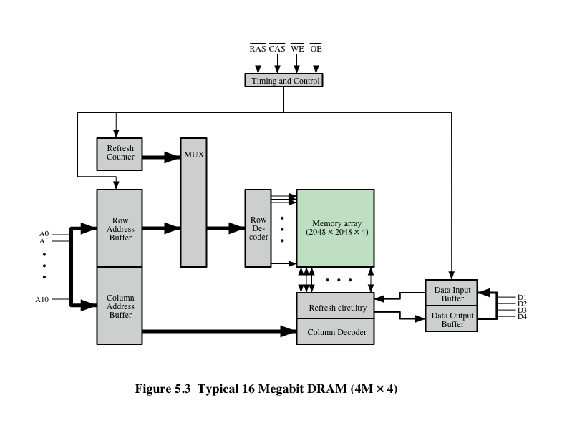
Tipik16 Mb DRAM (4M x 4)
Notes:
Figure 5.3 shows a typical organization of a 16-Mbit DRAM. In this case, 4 bits
are read or written at a time. Logically, the memory array is organized as four square
arrays of 2048 by 2048 elements. Various physical arrangements are possible. In any
case, the elements of the array are connected by both horizontal (row) and vertical
(column) lines. Each horizontal line connects to the Select terminal of each cell in its
row; each vertical line connects to the Data-In/Sense terminal of each cell in its column.
Address lines supply the address of the word to be selected. A total of log₂ W
lines are needed. In our example, 11 address lines are needed to select one of 2048
rows. These 11 lines are fed into a row decoder, which has 11 lines of input and 2048
lines for output. The logic of the decoder activates a single one of the 2048 outputs
depending on the bit pattern on the 11 input lines (2¹¹ = 2048).
An additional 11 address lines select one of 2048 columns of 4 bits per column.
Four data lines are used for the input and output of 4 bits to and from a data buffer.
On input (write), the bit driver of each bit line is activated for a 1 or 0 according to
the value of the corresponding data line. On output (read), the value of each bit line
is passed through a sense amplifier and presented to the data lines. The row line
selects which row of cells is used for reading or writing.
Because only 4 bits are read/written to this DRAM, there must be multiple
DRAMs connected to the memory controller to read/write a word of data to the bus.
Note that there are only 11 address lines (A0–A10), half the number you
would expect for a 2048 * 2048 array. This is done to save on the number of pins.
The 22 required address lines are passed through select logic external to the chip
and multiplexed onto the 11 address lines. First, 11 address signals are passed to the
chip to define the row address of the array, and then the other 11 address signals are
presented for the column address.
As an aside, multiplexed addressing plus the use of square arrays result in a
quadrupling of memory size with each new generation of memory chips. One more
pin devoted to addressing doubles the number of rows and columns, and so the size
of the chip memory grows by a factor of 4.
Figure 5.3 also indicates the inclusion of refresh circuitry. All DRAMs require
a refresh operation. A simple technique for refreshing is, in effect, to disable the
DRAM chip while all data cells are refreshed. The refresh counter steps through all
of the row values. For each row, the output lines from the refresh counter are supplied
to the row decoder and the RAS line is activated. The data are read out and
written back into the same location. This causes each cell in the row to be refreshed.

Slide 14
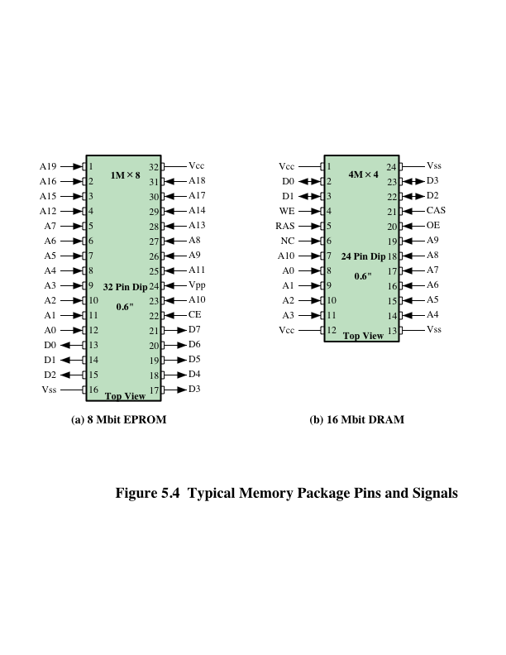
Cip Ambalajı (Chip Packaging)
Notes:
As was mentioned in Chapter 2, an integrated circuit is mounted on a package that
contains pins for connection to the outside world.
Figure 5.4a shows an example EPROM package, which is an 8-Mbit chip
organized as 1M * 8. In this case, the organization is treated as a one-word-per-chip
package. The package includes 32 pins, which is one of the standard chip package
sizes. The pins support the following signal lines:
• The address of the word being accessed. For 1M words, a total of 20 (2²⁰ = 1M)
pins are needed (A0–A19).
• The data to be read out, consisting of 8 lines (D0–D7).
• The power supply to the chip (V_{cc}).
• A ground pin (V_{ss}).
• A chip enable (CE) pin. Because there may be more than one memory chip,
each of which is connected to the same address bus, the CE pin is used to indicate
whether or not the address is valid for this chip. The CE pin is activated
by logic connected to the higher-order bits of the address bus (i.e., address bits
above A19). The use of this signal is illustrated presently.
• A program voltage (V_{pp}) that is supplied during programming (write operations).
A typical DRAM pin configuration is shown in Figure 5.4b, for a 16-Mbit chip
organized as 4M * 4. There are several differences from a ROM chip. Because
a RAM can be updated, the data pins are input/output. The write enable (WE)
and output enable (OE) pins indicate whether this is a write or read operation.
Because the DRAM is accessed by row and column, and the address is multiplexed,
only 11 address pins are needed to specify the 4M row/column combinations
(2¹¹ * 2¹¹ = 2²² = 4M). The functions of the row address select (RAS) and column
address select (CAS) pins were discussed previously. Finally, the no connect (NC)
pin is provided so that there are an even number of pins.

Slide 15
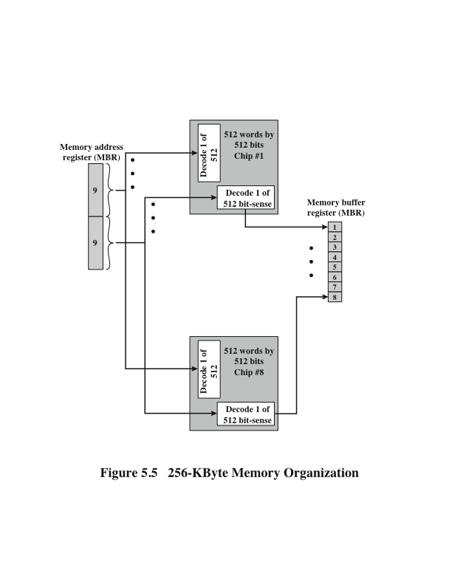
Şekil 5.5
256-KByte
Bellek Organizasyonu
Notes:
If a RAM chip contains only 1 bit per word, then clearly we will need at least a
number of chips equal to the number of bits per word. As an example, Figure 5.5
shows how a memory module consisting of 256K 8-bit words could be organized. For
256K words, an 18-bit address is needed and is supplied to the module from some
external source (e.g., the address lines of a bus to which the module is attached).
The address is presented to 8 256K * 1-bit chips, each of which provides the input/
output of 1 bit.

Slide 16
1MByte Modül Organizasyonu
Notes:
This organization works as long as the size of memory equals the number of
bits per chip. In the case in which larger memory is required, an array of chips is
needed. Figure 5.6 shows the possible organization of a memory consisting of 1M
word by 8 bits per word. In this case, we have four columns of chips, each column
containing 256K words arranged as in Figure 5.5. For 1M word, 20 address lines are
needed. The 18 least significant bits are routed to all 32 modules. The high-order
2 bits are input to a group select logic module that sends a chip enable signal to one
of the four columns of modules.

Slide 17
Geçmeli Bellek (Interleaved Memory)
Bir yığın DRAM yongasından oluşur
Bir bellek bankası oluşturmak için birlikte gruplandırılırlar
Her banka bağımsız olarak bir bellek okuma veya yazma isteğine hizmet edebilir
K adet banka K adet isteğe aynı anda hizmet edebilir, bellek okuma veya yazma oranlarını K katına artırır
Ardışık bellek kelimeleri farklı bankalarda saklanırsa, bir bellek bloğu aktarımı hızlandırılır
Notes:
Main memory is composed of a collection of DRAM memory chips. A number of
chips can be grouped together to form a memory bank. It is possible to organize
the memory banks in a way known as interleaved memory. Each bank is independently
able to service a memory read or write request, so that a system with
K banks can service K requests simultaneously, increasing memory read or write
rates by a factor of K. If consecutive words of memory are stored in different
banks, then the transfer of a block of memory is speeded up. Appendix E explores
the topic of interleaved memory.

Slide 18
Hata Düzeltme
Donanımsal Hata
Kalıcı fiziksel kusur
Bellek hücresi veya etkilenen hücreler güvenilir şekilde veri depolayamaz, ancak 0 veya 1'de sıkışabilir veya 0 ile 1 arasında hatalı bir şekilde geçiş yapabilir
Nedenleri:
Sert çevresel kullanım
Üretim kusurları
Üretim hatası
Yazılımsal Hata
Bir veya daha fazla bellek hücresinin içeriğini değiştiren rastgele, tahribatsız olay
Bellekte kalıcı hasar oluşmaz
Nedenleri:
Güç kaynağı sorunları
Alfa parçacıkları (Alpha particles)
Notes:
A semiconductor memory system is subject to errors. These can be categorized as
hard failures and soft errors. A hard failure is a permanent physical defect so that
the memory cell or cells affected cannot reliably store data but become stuck at
0 or 1 or switch erratically between 0 and 1. Hard errors can be caused by harsh
environmental abuse, manufacturing defects, and wear. A soft error is a random,
nondestructive event that alters the contents of one or more memory cells without
damaging the memory. Soft errors can be caused by power supply problems
or alpha particles. These particles result from radioactive decay and are distressingly
common because radioactive nuclei are found in small quantities in nearly all
materials. Both hard and soft errors are clearly undesirable, and most modern main
memory systems include logic for both detecting and correcting errors.

Slide 19
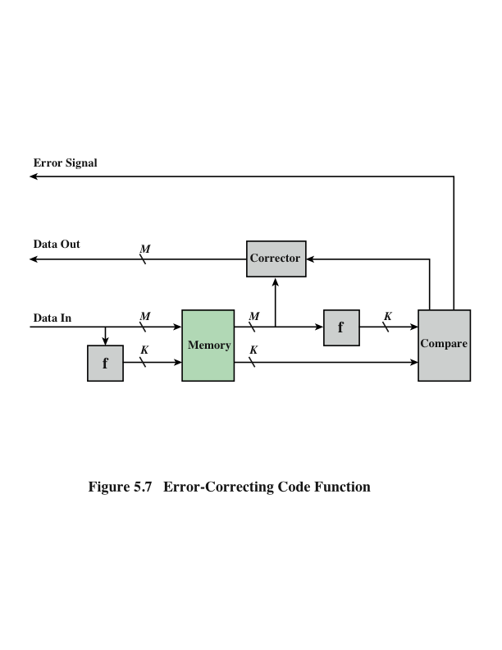
Hata Düzeltme Kod İşlevi
Notes:
Figure 5.7 illustrates in general terms how the process is carried out. When
data are to be written into memory, a calculation, depicted as a function f, is performed
on the data to produce a code. Both the code and the data are stored. Thus,
if an M-bit word of data is to be stored and the code is of length K bits, then the
actual size of the stored word is M + K bits.
When the previously stored word is read out, the code is used to detect and possibly
correct errors. A new set of K code bits is generated from the M data bits and
compared with the fetched code bits. The comparison yields one of three results:
• No errors are detected. The fetched data bits are sent out.
• An error is detected, and it is possible to correct the error. The data bits plus
error correction bits are fed into a corrector, which produces a corrected set of
M bits to be sent out.
• An error is detected, but it is not possible to correct it. This condition is reported.
Codes that operate in this fashion are referred to as error-correcting codes. A
code is characterized by the number of bit errors in a word that it can correct and detect.

Slide 20
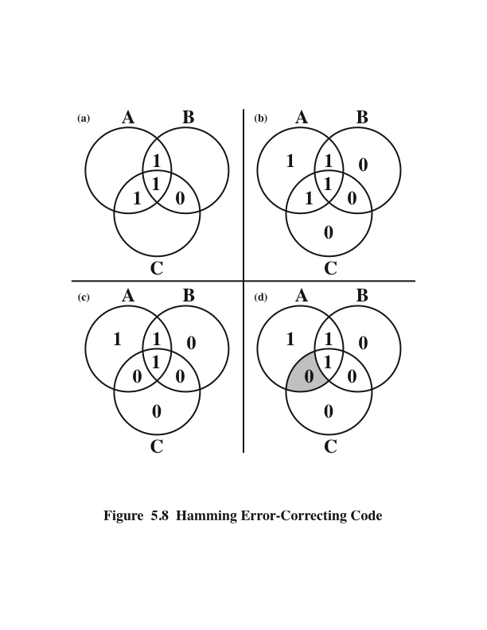
Hamming Hata Düzeltme Kodu
Notes:
The simplest of the error-correcting codes is the Hamming code devised by
Richard Hamming at Bell Laboratories. Figure 5.8 uses Venn diagrams to illustrate
the use of this code on 4-bit words (M = 4). With three intersecting circles,
there are seven compartments. We assign the 4 data bits to the inner compartments
(Figure5.8a). The remaining compartments are filled with what are called parity
bits. Each parity bit is chosen so that the total number of 1s in its circle is even
(Figure5.8b). Thus, because circle A includes three data 1s, the parity bit in that
circle is set to 1. Now, if an error changes one of the data bits (Figure 5.8c), it is easily
found. By checking the parity bits, discrepancies are found in circle A and circle
C but not in circle B. Only one of the seven compartments is in A and C but not B.
The error can therefore be corrected by changing that bit.

Slide 21
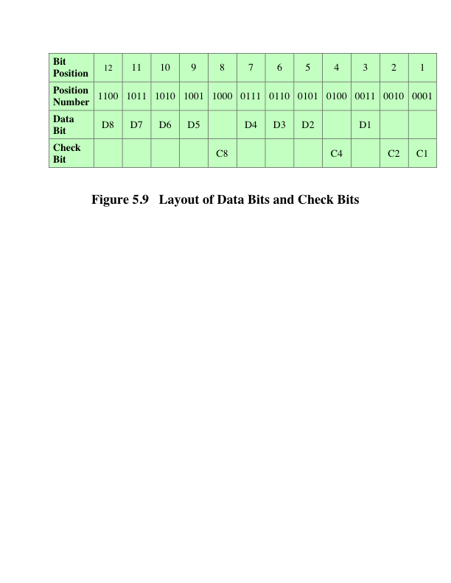
Veri Bitleri ve Kontrol Bitleri Düzeni
Notes:
To achieve these characteristics, the data and check bits are arranged into a
12-bit word as depicted in Figure 5.9. The bit positions are numbered from 1 to 12.
Those bit positions whose position numbers are powers of 2 are designated as check
bits.

Slide 22
Veri Bitleri ve Kontrol Bitleri Düzeni

Slide 23
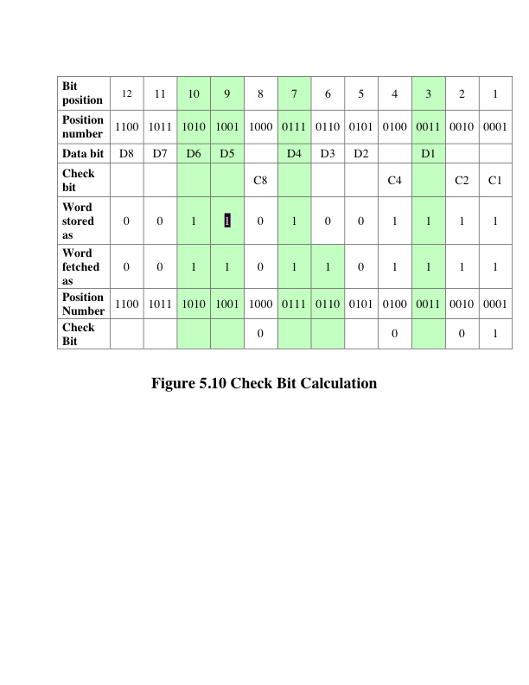
Kontrol Biti Hesaplaması
Notes:
Figure 5.10 illustrates the calculation. The data and check bits are
positioned properly in the 12-bit word. Four of the data bits have a value 1 (shaded
in the table), and their bit position values are XORed to produce the Hamming
code 0111, which forms the four check digits. The entire block that is stored is
001101001111. Suppose now that data bit 3, in bit position 6, sustains an error and is
changed from 0 to 1. The resulting block is 001101101111, with a Hamming code of
0111. An XOR of the Hamming code and all of the bit position values for nonzero
data bits results in 0110. The nonzero result detects an error and indicates that the
error is in bit position 6.

Slide 24
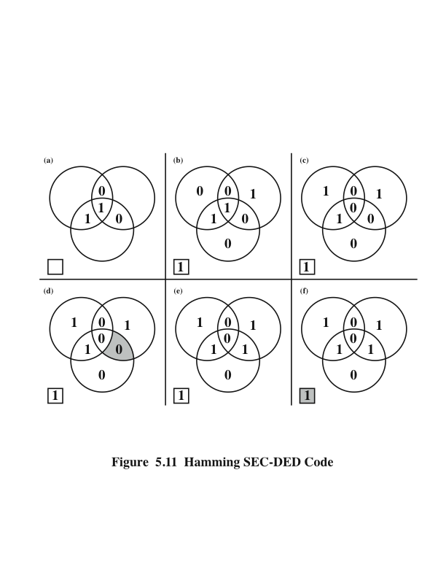
Hamming SEC-DED Kodu
Notes:
The code just described is known as a single-error-correcting (SEC) code.
More commonly, semiconductor memory is equipped with a single-error-correcting,
double-error-detecting (SEC-DED) code. As Table 5.2 shows, such codes require
one additional bit compared with SEC codes.
Figure 5.11 illustrates how such a code works, again with a 4-bit data word.
The sequence shows that if two errors occur (Figure 5.11c), the checking procedure
goes astray (d) and worsens the problem by creating a third error (e). To overcome
the problem, an eighth bit is added that is set so that the total number of 1s in the
diagram is even. The extra parity bit catches the error (f).
An error-correcting code enhances the reliability of the memory at the cost of
added complexity. With a 1-bit-per-chip organization, an SEC-DED code is generally
considered adequate. For example, the IBM 30xx implementations used an 8-bit SECDED
code for each 64 bits of data in main memory. Thus, the size of main memory is
actually about 12% larger than is apparent to the user. The VAX computers used a 7-bit
SEC-DED for each 32 bits of memory, for a 22% overhead. A number of contemporary
DRAMs use 9 check bits for each 128 bits of data, for a 7% overhead [SHAR97].

Slide 25
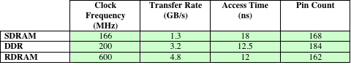
Gelişmiş DRAM Organizasyonu
SDRAM
Ana dahili bellek için arayüz olan yüksek performanslı işlemcileri kullanırken karşılaşılan en kritik sistem darboğazlarından biri,
Geleneksel DRAM çipi hem iç mimarisi hem de işlemcinin bellek veri yoluna olan arayüzü ile sınırlandırılmıştır,
Temel DRAM mimarisi için birkaç geliştirme:
DDR-DRAM
RDRAM
Tablo 5.3 Bazı DRAM Alternatiflerinin Performanslarının Karşılaştırılması
Notes:
As discussed in Chapter 2, one of the most critical system bottlenecks when using
high-performance processors is the interface to main internal memory. This interface
is the most important pathway in the entire computer system. The basic building
block of main memory remains the DRAM chip, as it has for decades; until
recently, there had been no significant changes in DRAM architecture since the
early 1970s. The traditional DRAM chip is constrained both by its internal architecture
and by its interface to the processor’s memory bus.
We have seen that one attack on the performance problem of DRAM
main memory has been to insert one or more levels of high-speed SRAM cache
between the DRAM main memory and the processor. But SRAM is much costlier
than DRAM, and expanding cache size beyond a certain point yields diminishing
returns.
In recent years, a number of enhancements to the basic DRAM architecture
have been explored, and some of these are now on the market. The schemes that currently
dominate the market are SDRAM, DDR-DRAM, and RDRAM. Table 5.3
provides a performance comparison. CDRAM has also received considerable attention.
We examine each of these approaches in this section.

Slide 26
Eşzamanlı DRAM (SDRAM)
DRAM‘in en çok kullanılan formlarından biri
Harici saat sinyallerine senkronize olmuş işlemci ve tam kapasitede çalışan işlemci/bellek ile veri alışverişleri zorlanmaksızın durumları bekler.
Eşzamanlı erişimle DRAM, verileri sistem saatinin kontrolü altında içeri ve dışarı doğru taşır
İşlemci ve diğer ana görevler DRAM’de saklanmış olan komut ve adres bilgilerini verir
DRAM belirli sayıda saat çevriminden sonra yanıt verir
Bu arada, SDRAM işlenirken ana makine diğer görevleri güvenle yerine getirebilir
Notes:
One of the most widely used forms of DRAM is the synchronous DRAM
(SDRAM) [VOGL94]. Unlike the traditional DRAM, which is asynchronous, the
SDRAM exchanges data with the processor synchronized to an external clock signal
and running at the full speed of the processor/memory bus without imposing
wait states.
In a typical DRAM, the processor presents addresses and control levels to
the memory, indicating that a set of data at a particular location in memory should
be either read from or written into the DRAM. After a delay, the access time, the
DRAM either writes or reads the data. During the access-time delay, the DRAM
performs various internal functions, such as activating the high capacitance of the
row and column lines, sensing the data, and routing the data out through the output
buffers. The processor must simply wait through this delay, slowing system
performance.
With synchronous access, the DRAM moves data in and out under control of
the system clock. The processor or other master issues the instruction and address
information, which is latched by the DRAM. The DRAM then responds after a set
number of clock cycles. Meanwhile, the master can safely do other tasks while the
SDRAM is processing the request.

Slide 27
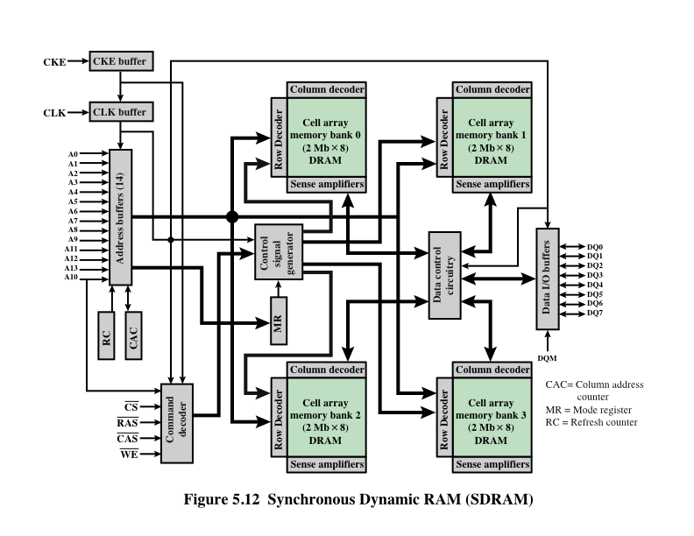
SDRAM
Notes:
Figure 5.12 shows the internal logic of IBM’s 64-Mb SDRAM [IBM01], which
is typical of SDRAM organization.

Slide 28
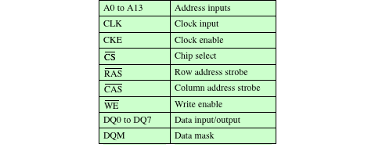
SDRAM Pin Ataması
Table 5.4 SDRAM Pin Assignments
Notes:
Table 5.4 defines the various pin assignments.
The SDRAM employs a burst mode to eliminate the address setup time and
row and column line pre-charge time after the first access. In burst mode, a series of
data bits can be clocked out rapidly after the first bit has been accessed. This mode
is useful when all the bits to be accessed are in sequence and in the same row of the
array as the initial access. In addition, the SDRAM has a multiple-bank internal
architecture that improves opportunities for on-chip parallelism.
The mode register and associated control logic is another key feature differentiating
SDRAMs from conventional DRAMs. It provides a mechanism to
customize the SDRAM to suit specific system needs. The mode register specifies
the burst length, which is the number of separate units of data synchronously fed
onto the bus. The register also allows the programmer to adjust the latency between
receipt of a read request and the beginning of data transfer.
The SDRAM performs best when it is transferring large blocks of data serially,
such as for applications like word processing, spreadsheets, and multimedia.

Slide 29
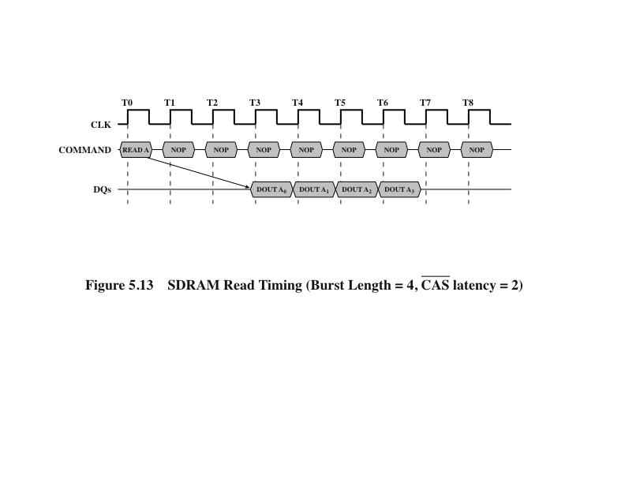
SDRAM Okuma Zamanlaması
Notes:
Figure 5.13 shows an example of SDRAM operation.

Slide 30
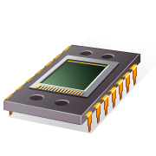
RDRAM
Rambus Tarafından Geliştirilmiş
Pentium ve Itanium işlemcileri için Intel tarafından adapte edildi
SDRAM’in ana rakibi
Çipler tüm pinleri bir tarafta olan dikey paketlerdir
İşlemci ile verileri, 28 telten fazla, 12 santimetreden uzun olmayan kablolar aracılığı ile değiş tokuş eder
Veri yolu 320 RDRAM yongasına kadar adresleyebilir ve 1,6 GBps olarak derecelendirilir.
Veri yolu, eşzamanlı olmayan bir blok odaklı protokol kullanarak adres ve kontrol bilgisini iletir
Yüksek hızlı veri yolu üzerinden bellek isteği alır
İstek, istenilen adresi, işlem türünü ve işlemdeki bayt sayısını içerir
Notes:
RDRAM, developed by Rambus [FARM92, CRIS97], has been adopted by Intel
for its Pentium and Itanium processors. It has become the main competitor to
SDRAM. RDRAM chips are vertical packages, with all pins on one side. The chip
exchanges data with the processor over 28 wires no more than 12 centimeters long.
The bus can address up to 320 RDRAM chips and is rated at 1.6 GBps.
The special RDRAM bus delivers address and control information using
an asynchronous block-oriented protocol. After an initial 480 ns access time,
this produces the 1.6 GBps data rate. What makes this speed possible is the bus
itself, which defines impedances, clocking, and signals very precisely. Rather than
being controlled by the explicit RAS, CAS, R/W, and CE signals used in conventional
DRAMs, an RDRAM gets a memory request over the high-speed bus. This
request contains the desired address, the type of operation, and the number of
bytes in the operation.

Slide 31
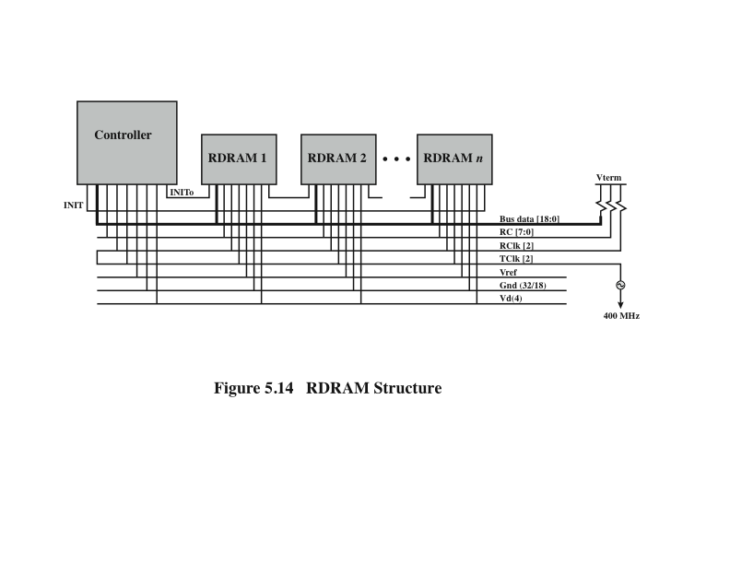
RDRAM Yapısı
Notes:
Figure 5.14 illustrates the RDRAM layout. The configuration consists of
a controller and a number of RDRAM modules connected via a common bus.
The controller is at one end of the configuration, and the far end of the bus is
a parallel termination of the bus lines. The bus includes 18 data lines (16 actual
data, two parity) cycling at twice the clock rate; that is, 1 bit is sent at the leading
and following edge of each clock signal. This results in a signal rate on each
data line of 800 Mbps. There is a separate set of 8 lines (RC) used for address
and control signals. There is also a clock signal that starts at the far end from
the controller propagates to the controller end and then loops back. A RDRAM
module sends data to the controller synchronously to the clock to master, and the
controller sends data to an RDRAM synchronously with the clock signal in the
opposite direction. The remaining bus lines include a reference voltage, ground,
and power source.

Slide 32
Double Data Rate SDRAM (DDR SDRAM)
SDRAM, veri yolu saat döngüsü başına sadece veri gönderebilir
Double-data-rate SDRAM, biri saat darbesinin yükselen kenarı üzerinde ve diğeri düşen kenarda olmak üzere saat döngüsü başına iki kez veri gönderebilir
JEDEC Solid State Technology Association (Electronic Industries Alliance’s semiconductor-engineering-standardization body) tarafından geliştirilmiştir
Notes:
SDRAM is limited by the fact that it can only send data to the processor once per
bus clock cycle. A new version of SDRAM, referred to as double-data-rate SDRAM
can send data twice per clock cycle, once on the rising edge of the clock pulse and
once on the falling edge.
DDR DRAM was developed by the JEDEC Solid State Technology
Association, the Electronic Industries Alliance’s semiconductor-engineering-standardization
body. Numerous companies make DDR chips, which are widely used in
desktop computers and servers.

Slide 33
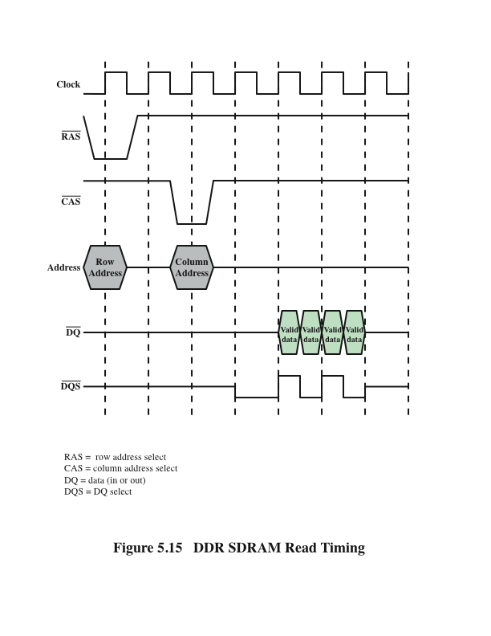
DDR SDRAM Okuma Zamanlaması
Notes:
Figure 5.15 shows the basic timing for a DDR read. The data transfer is synchronized
to both the rising and falling edge of the clock. It is also synchronized to
a bidirectional data strobe (DQS) signal that is provided by the memory controller
during a read and by the DRAM during a write. In typical implementations the
DQS is ignored during the read. An explanation of the use of DQS on writes is
beyond our scope; see [JACO08] for details.
There have been two generations of improvement to the DDR technology.
DDR2 increases the data transfer rate by increasing the operational frequency
of the RAM chip and by increasing the prefetch buffer from 2 bits to 4 bits
per chip. The prefetch buffer is a memory cache located on the RAM chip. The
buffer enables theRAM chip to preposition bits to be placed on the data bus as
rapidly as possible. DDR3, introduced in 2007, increases the prefetch buffer size
to 8 bits.
Theoretically, a DDR module can transfer data at a clock rate in the range of
200 to 600 MHz; a DDR2 module transfers at a clock rate of 400 to 1066 MHz; and
a DDR3 module transfers at a clock rate of 800 to 1600 MHz. In practice, somewhat
smaller rates are achieved.
Appendix K provides more detail on DDR technology.

Slide 34
Cache DRAM (CDRAM)
Mitsubishi tarafından geliştirlmiştir
Küçük bir SRAM önbelleğini jenerik bir DRAM yongasına entegre eder.
CDRAM üzerindeki SRAM iki şekilde kullanılabilir:
Bir dizi 64-bit hattından oluşan gerçek bir önbellek olarak kullanılabilir
CDRAM'in önbellek modu, sıradan rastgele bellek erişimi için etkilidir
Bir veri bloğunun seri erişimini desteklemek için bir tampon olarak da kullanılabilir
Notes:
Cache DRAM (CDRAM), developed by Mitsubishi [HIDA90, ZHAN01], integrates
a small SRAM cache (16 Kb) onto a generic DRAM chip.
The SRAM on the CDRAM can be used in two ways. First, it can be used as a
true cache, consisting of a number of 64-bit lines. The cache mode of the CDRAM
is effective for ordinary random access to memory.
The SRAM on the CDRAM can also be used as a buffer to support the serial
access of a block of data. For example, to refresh a bit-mapped screen, the CDRAM
can prefetch the data from the DRAM into the SRAM buffer. Subsequent accesses
to the chip result in accesses solely to the SRAM.

Slide 35
Özet
Dahili Bellek
Bölüm5
Yarıiletken ana bellek
Organizasyon
DRAM ve SRAM
ROM çeşitleri
Çip mantığı
Çip ambalajı
Modül Organizasyonu
Geçmeli Bellek
Hata Düzeltme
Donanım Hatası
Yazılım Hatası
Hamming kodu
Gelişmiş DRAM organizasyonu
Eşzmanalı DRAM
Rambus DRAM
DDR SDRAM
Cache DRAM
Notes:
Chapter 5 summary.

